Slide 1
Plagiarism
Plagiarism means taking ideas or words from a source (e.g. a book or journal) without giving credit (acknowledgement) to the author.
It is seen as a kind of theft, and is considered to be an academic crime.
In academic work, ideas and words are seen as private property belong - ing to the person who first thought or wrote them.
Therefore, it is important for all students, to understand the meaning of plagiarism and learn how to prevent it in their work.

Slide 2
There are several reasons why students must avoid plagiarism:
To show that they understand the rules of the academic community
Copying the work of others will not help them develop their own understanding
Plagiarism is easily detected by teachers and computer software

Slide 3
Summarizing and Paraphrasing

Slide 4
Summarizing and Paraphrasing
Summarizing and paraphrasing are normally used together in essay writing.
Summarizing aims to reduce information to a suitable length.
the writer condenses lengthy sources into a concise form.
While
paraphrasing means changing the wording of a text so that it is significantly different from the original source, without changing the meaning.

Slide 5
Paraphrasing
Example
There has been much debate about the reasons for the Industrial Revolution happening in eighteenth-century Britain, rather than in France or Germany.
could be paraphrased:
Why the Industrial Revolution occurred in Britain in the eighteenth century, instead of on the continent, has been the subject of considerable discussion
Both are needed to avoid the risk of plagiarism

Slide 6
She angered me with her inappropriate comments, rumor-spreading, and disrespectfulness at the formal dinner table.
She made me angry when she was rude at dinner.
Her impoliteness, gossiping, and general lack of respect at dinner infuriated me.
Her impoliteness, gossiping, and general lack of respect at dinner infuriated me.
I was mad when she started spreading rumors, making inappropriate comments, and disrespecting other guests at our dinner.

Slide 7
Paraphrasing
“Paraphrase” is a verb which means to re-write a phrase or sentence with the same meaning but using different words.

Slide 8
Paraphrasing 1
For Example:
"Paraphrasing is a very important skill for most English tests.“
Paraphrased:
"For many tests of English, being skilful at paraphrasing is extremely important.“
changes some vocabulary (e.g. “extremely” for “very”)
changes the word order (e.g., “tests of English” for “English tests”)
changes the grammar (e.g., “being skilful at paraphrasing…” for “Paraphrasing is a very important skill…”)
These are the three main ways to paraphrase and by combining all of these methods, you can achieve clear and accurate paraphrased sentences.

Slide 9
Techniques for paraphrasing
Changing vocabulary by using synonyms:
argues > claims
eighteenth century > 1700s
wages > labour costs
Economise > saving

Slide 10
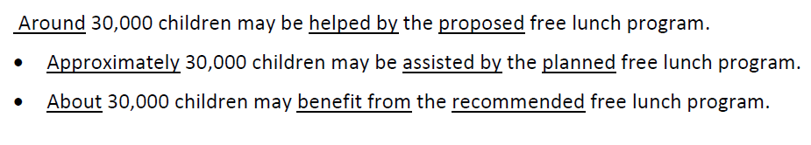

Slide 12
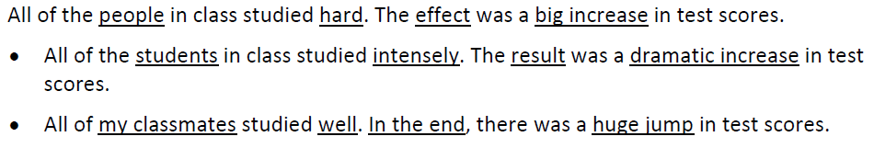

Slide 14
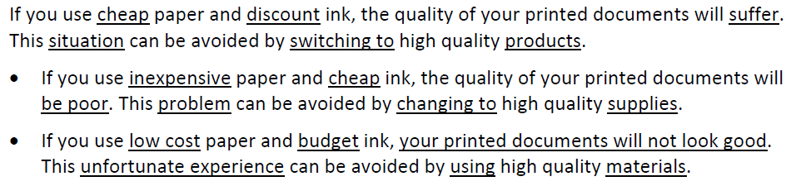

Slide 15
Change the underlined words with synonyms
Cell phone usage has exploded over the past decade and continues to rise. Today there are over one billion phone users worldwide. Concern has arisen over whether cell phone usage can harm a person’s health. Brain cancer rates in the United States have risen since cell phones were introduced, leading some people to wonder if cell phone usage is the reason for the increase.

Slide 16
Mobile phone usage has increased sharply over the past 10 years and continues to grow. Today there are more than one billion phone users around the globe. Questions have arisen over whether cell phone usage can negatively impact a person’s health. The number of brain cancer patients in the United States has increased since cell phones were introduced, leading some people to wonder if cell phone usage is the cause of the change.

Slide 17
Techniques for paraphrasing
Changing word class:
explanation (n.) > explain (v.)/
mechanical (adj.) > mechanise (v.)/
profitable (adj.) > profitability (n.)

Slide 18
Changing word class
1. To analyse (change to noun)
2. To analyse (change to adjective)
3. Evaluation (change to verb)
4. Theoretical (change to verb)
5. Problem (change to adjective)
6. To expect (change to noun)
7. To agree (change to opposite verb)
8. Organised (change to opposite adjective)
9. To prove (change to noun)
10.To prove (change to opposite verb)

Slide 19
Keys
1. analysis
2. analytical
3. to evaluate
4. to theorise
5. problematic
6. expectation
7. to disagree
8. disorganised
9. proof
10.to disprove

Slide 20
Techniques for paraphrasing
Changing word order:
. . . the best explanation for the British location of the Industrial Revolution is found by studying demand factors.
A focus on demand may help explain the UK origin of the Industrial Revolution.

Slide 21
Paraphrasing Method 1: Use Different Vocabulary with the Same Meaning
For example, look at this original sentence and two paraphrased equivalents:
"It can be difficult to choose a suitable place to study English.“
1. "It is often a challenge to pick up (x) a relevant (x) school to learn English.“
2. "It is sometimes hard to select an appropriate place to learn English."

Slide 22
Paraphrasing Method 2: Change the Order of Words
If the original sentence has two or more clauses, change the order of the clauses.
1. "If they have some help, most people can paraphrase effectively. However, practice is important because paraphrasing is difficult.“
2. "Most people can paraphrase effectively, if they have some help. Paraphrasing is difficult, however, so practice is important."

Slide 23
Paraphrasing Method 3: Use Different Grammar
If the original sentence is in the active voice, change it to passive or vice versa.
1. "To improve English, you should learn new vocabulary on a daily basis.“
2. "To improve English, new vocabulary should be learned on a daily basis"

Slide 24
Common Knowledge
“Material is probably common knowledge if . .
You find the same information undocumented in at least five other sources
You think it is information that your readers will already know
You think a person could easily find the information with general reference sources

Slide 25
Steps to Effective Paraphrasing
Reread the original passage until you understand its full meaning.
Set the original aside, and write your paraphrase
Check your rendition with the original to make sure that your version accurately expresses all the essential information in a new form.
Use quotation marks to identify any unique term or phraseology you have borrowed exactly from the source.
Record the source (including the page) on your note card so that you can credit it easily

Slide 26
Paraphrase the following sentences.
The student requested that the professor excuses her absence, but the professor refused.
There will be a music concert next to Vienna coffee shop. Would you like to go?
International Center is hosting English Conversation classes. They help non-native speakers of English practice their English speaking skills.
The office of International Students and Scholars at Purdue University is located in Schleman Hall.
The car that was pulled over by the police officer yesterday just had an accident. That driver is not careful.

Slide 27
Possible Solution:
The professor denied the student’s request for an excused absence.
Are you coming to a music concert in Vienna?
English non native speakers can improve their English by taking classes at International Center.
Schleman Hall hosts the ISS office.
The driver who was pulled over yesterday is not careful because he just had an accident.

Slide 28
Paraphrase
Language is the main means of communication between peoples. But so many different languages have developed that language has often been a barrier rather than an aid to understanding among peoples. For many years, people have dreamed of setting up an international universal language which all people are simple and obvious. If all people spoke the same tongue, cultural and economic ties might be much closer, and good will increase between countries (Kispert, 2004).

Slide 29
Summarizing
Summarizing aims to reduce information to a suitable length.
the writer condenses lengthy sources into a concise form.

Slide 30
Summarizing
"Mr. Leibovitz and writer Matthew Miller joined forces to tell the story of the students in their book, “Fortunate Sons.” The book says China sent one hundred twenty boys to America to learn about developments that could help modernize their country.” (American Documents the Country’s First Exchange Students from China, Voice of America, learningenglish.voanews.com)
“Fortunate Sons” tells the story of Chinese exchange students who came to the US in the 1870s to learn how to help their home nation.

Slide 31
Summarizing
“Illiteracy is a problem in many of the world’s poorest countries. Even in wealthier nations like the United States, many children struggle with reading and writing. But in 19 cities across the country United States, the volunteers of Experience Corps are helping youngsters learn to read. The volunteers, all over 50, work with students in low-income areas.” (Older Volunteers Help Children Learn to Read, Voice of America, voanews.com)
Older Experience Corps volunteers help poor children from 19 US cities improve their literacy skills.

Slide 32
Activity 1
“Women entrepreneurs in the developing world often face challenges that limit their chances for success and growth. They often have less access to education than men and have difficulty getting financing on their own. But with an understanding of the essential aspects of doing business – such as planning, financing, networking and marketing – they can overcome those obstacles. That's where the 10,000 Women Initiative comes in. As Faiza Elmasry tells us, it's an investment in education with dividends that benefit the businesswomen, their local communities and their national economies.” (Goldman Sachs invests in Educating Women in Business, Voice of America, voanews.com)

Slide 33
Activity 2
The twenties were the years when drinking was against the law, and the law was a bad joke because everyone knew of a local bar where liquor could be had. They were the years when organized crime ruled the cities, and the police seemed powerless to do anything against it. Classical music was forgotten while jazz spread throughout the land, and men like Bix Beiderbecke, Louis Armstrong, and Count Basie became the heroes of the young. The flapper was born in the twenties, and with her bobbed hair and short skirts, she symbolized, perhaps more than anyone or anything else, America's break with the past. From Kathleen Yancey, English 102 Supplemental Guide (1989): 25.

Slide 34
Acknowledging sources
If you borrow from or refer to the work of another person, you must show that you have done this by providing the correct acknowledgement.
There are two ways to do this:
Summary and citation
Smith (2009) claims that the modern state wields power in new ways.
Quotation and citation
According to Smith: ‘The point is not that the state is in retreat but that it is developing new forms of power . . .’ (Smith, 2009: 103).

Slide 35
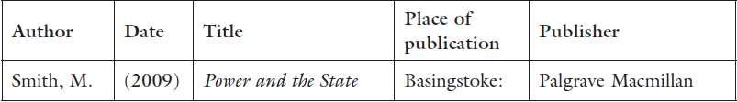
These in-text citations are linked to a list of references at the end of the main text, which includes the following details:
The citation makes it clear to the reader that you have read Smith and borrowed this idea from him. This reference gives the reader the necessary information to find the source if the reader needs more detail.

Slide 36
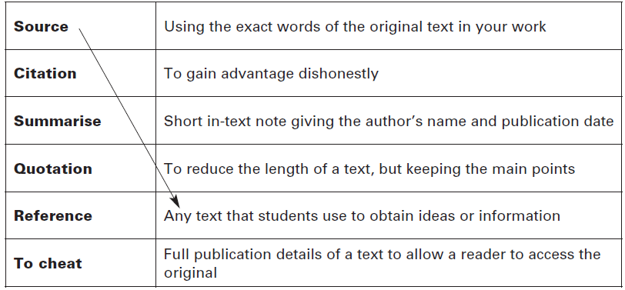

Slide 37
Clearly, tattooing has emerged from the underbelly to the surface of the American landscape. And as the popularity of tattoos has expanded, so has the art itself. No longer restricted to Bettie Page look-alikes, muddy blue anchors, and ribbon-wrapped hearts reading “Mom,” today’s tattoo images make bold statements of personality, as individualized and varied as any art form. (xiii)
It’s a fact that tattoos have arisen from the underbelly to the top of the American landscape. Tattooing has experienced a growing popularity, and so has the art itself. It is no longer limited to sailor-style ships and blue anchors, or biker-type hearts reading “Mom.” Today’s images include bold statements of individualized personality as diverse as any art form (Addonizio and Dumesnil xiii).

Slide 38
Clearly, tattooing has emerged from the underbelly to the surface of the American landscape. And as the popularity of tattoos has expanded, so has the art itself. No longer restricted to Bettie Page look-alikes, muddy blue anchors, and ribbon-wrapped hearts reading “Mom,” today’s tattoo images make bold statements of personality, as individualized and varied as any art form. (xiii)
It’s a fact that tattoos have arisen from the underbelly to the top of the American landscape. Tattooing has experienced a growing popularity, and so has the art itself. It is no longer limited to sailor-style ships and blue anchors, or biker-type hearts reading “Mom.” Today’s images include bold statements of individualized personality as diverse as any art form (Addonizio and Dumesnil xiii).

Slide 39
Paraphrasing
Note that an effective paraphrase usually:
has a different structure to the original
has mainly different vocabulary
retains the same meaning
keeps some phrases from the original that are in common use (e.g. ‘Industrial Revolution’ or ‘eighteenth century’)

Slide 40
Paraphrasing
The student requested that the professor excuses her absence, but the professor refused.
Possible Solution: The professor denied the student’s request for an excused absence.
2. There will be a music concert next to Vienna coffee shop. Would you like to go?
Possible Solution: Are you coming to a music concert in Vienna?
3. International Center is hosting English Conversation classes. They help non-native speakers of English practice their English speaking skills.
Possible Solution: English non native speakers can improve their English by taking classes at International Center.

Slide 41
Paraphrasing
4. The office of International Students and Scholars (ISS) at Purdue University is located in Schleman Hall.
Possible Solution: Schleman Hall hosts the ISS office.
5. The car that was pulled over by the police officer yesterday just had an accident. That driver is not careful.
Possible Solution: The driver who was pulled over yesterday is not careful because he just had an accident.

Slide 42
Techniques for paraphrasing
Changing vocabulary by using synonyms:
argues > claims
eighteenth century > 1700s
wages > labour costs
Economise > saving

Slide 43
Techniques for paraphrasing
Changing word class:
explanation (n.) > explain (v.)/
mechanical (adj.) > mechanise (v.)/
profitable (adj.) > profitability (n.)

Slide 44
Techniques for paraphrasing
Changing word order:
. . . the best explanation for the British location of the Industrial Revolution is found by studying demand factors.
A focus on demand may help explain the UK origin of the Industrial Revolution.

Slide 45
An example of acceptable paraphrasing:
New York is referred to as “the city that never sleeps.” At nights, people can be assured that something is going on no matter what the time.
In New York, there is something to do at all hours of the night.

Slide 46
: An example of unacceptable paraphrasing:
Brooklyn is the most populous of New York City's five boroughs, with approximately 2.5 million residents, and the second-largest in area.
Brooklyn is the most populous borough in New York City, with about 2.5 million residents, and is the second biggest area.

Slide 47
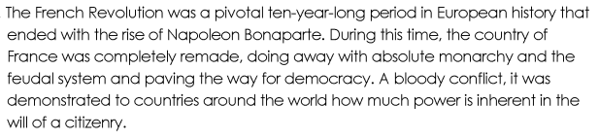

Slide 48


Slide 49
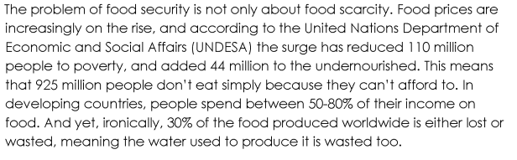

Slide 50


Slide 51
Paraphrasing
The United States, Germany, Japan and other industrial powers are being transformed from industrial economies to knowledge and information based service economies, whilst manufacturing has been moving to low wage countries. In a knowledge and information based economy, knowledge and information are the key ingredients in creating wealth.
other industrial powers = economies such as
transformed = dramatic change
whilst = as
has been moving = shifts to
low wage countries = countries where wages are low
key ingredients = focus on

Slide 52
Summarize the passage
Research on children’s advertising would not seem to support a ban. Psychology professor, Adrian Furnham, argues against any restrictions, noting “Peer influences and parenting styles are massively more influential in determining children’s behaviour and achievements than advertising” (Stokes and Brown, 2011). Furthermore, a German study points out that, on average, children between three and thirteen years old spend only 1.4% of their waking time watching adverts. That said, in the UK, this translates into 18 000 adverts a year (Grissom, 2010). However until there has been definitive research linking behaviour to advertising, it would seem premature to argue for a ban, but perhaps some regulation is needed, especially given parents’ concerns.

Slide 53
Key
There is little research to support a ban on children’s advertising as it does not seem to be that influential. One expert, Professor Furnham, argues parenting style and peer pressure are more important (Stokes and Brown, 2011), while a German study (Grissom, 2010) points out that children actually spend very little of their time, only 1.4%, watching adverts.

